Slide 1
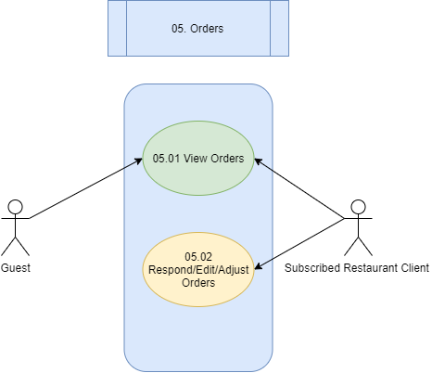
I3: Use-Case Diagrams

Slide 2
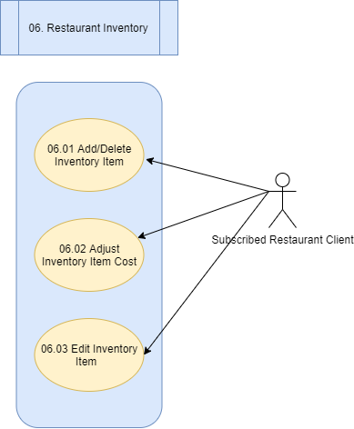
I3: Use-Case Diagrams

Slide 3
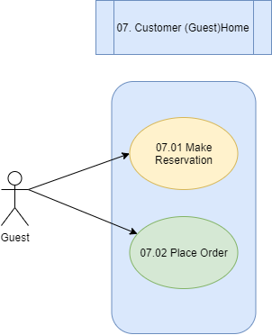
I3: Use-Case Diagrams

